Slide 1

Knowledge Graph Augmented Segmentation
Yifan Zhang, Imran Mohammed, Azhar Hasan
Motivation
Challenges
Contributions
Current segmentation methods have trouble dealing with glass objects.
They segment things through the glass, not the glass itself.
Dealing with glass can improve autonomous vehicles.
VLM has difficulty understanding domain-specific information, such as glass and objects seen through the glass.
Fine-tuning VLM is resource-intensive and time-consuming.
A formalized pipeline for incorporating knowledge into the polishing of segments.
A novel neural-symbolic approach that is extendable to any VLM.

Slide 2
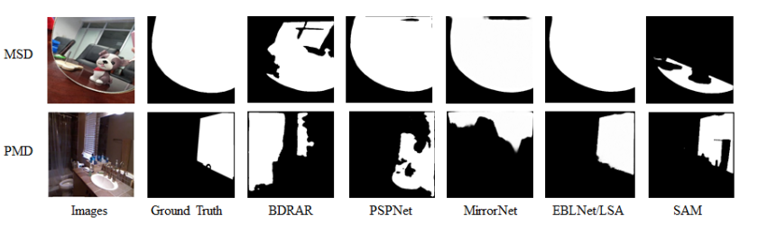
Compare with State of the Art
Current works include EBLNet, MirrorNet, PSPNet, and BDRAR.
Each of these models has impressive segmentation capabilities, but all fall short when segmenting glass and other see-through objects.
None utilizes symbolic systems to improve the understanding of what is glass and what is not.
We aim to prove that the use of a symbolic knowledge graph can improve glass segmentation.
We focus on improving Facebook’s SAM model.

Slide 3
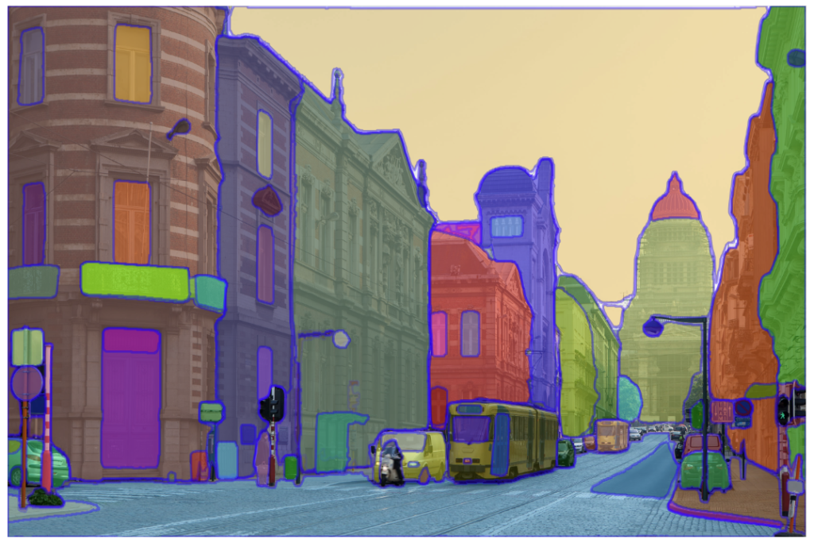

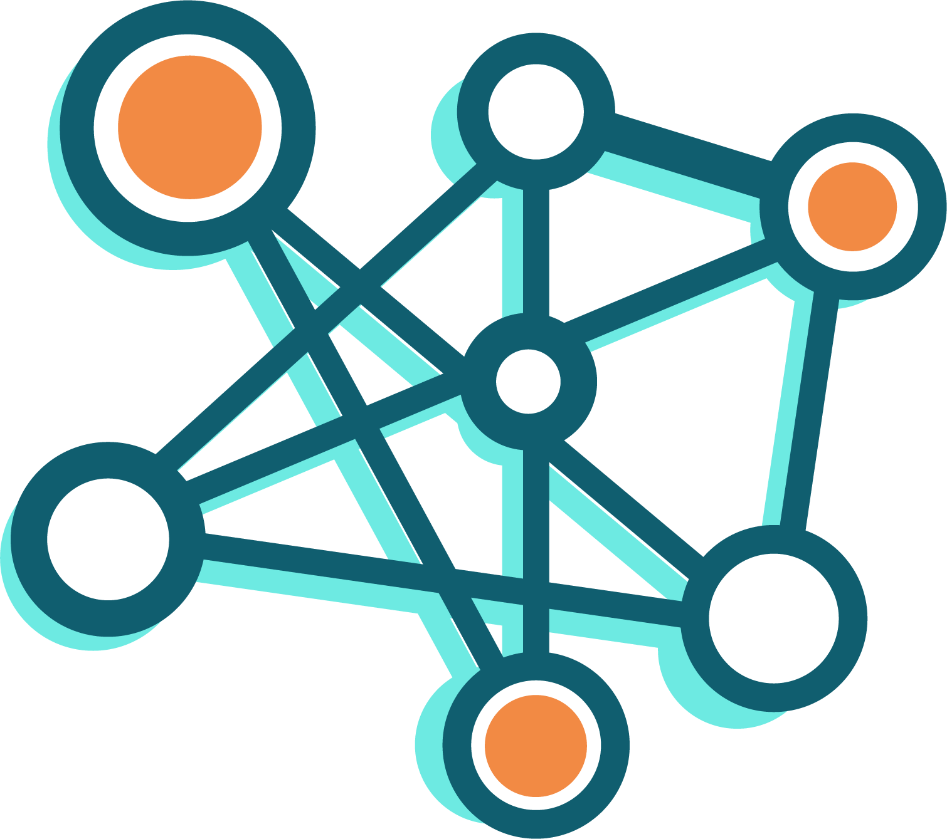
Overview of Your Solution with a figure
refine
define
Image Segments (by SAM)
Knowledge Graph
Knowledge Base (Expertise)
Refined Segments
(some will be merged based on the information provided by KG)

Slide 4
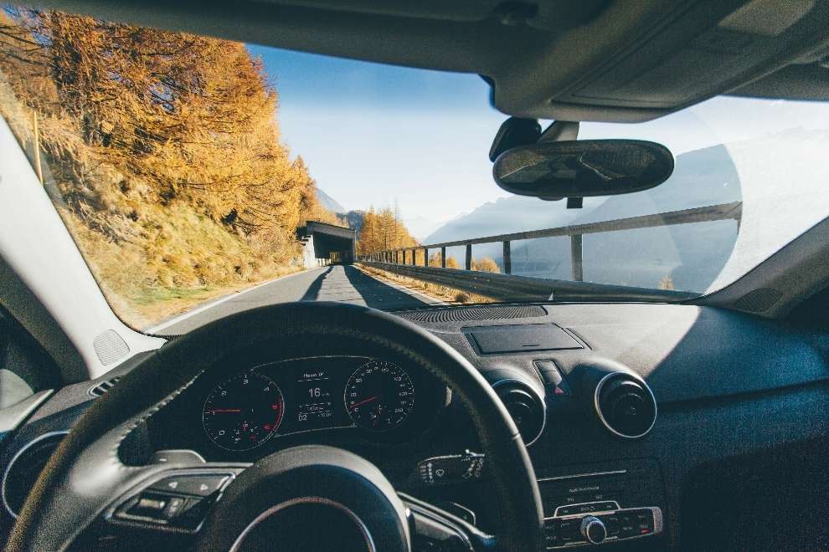
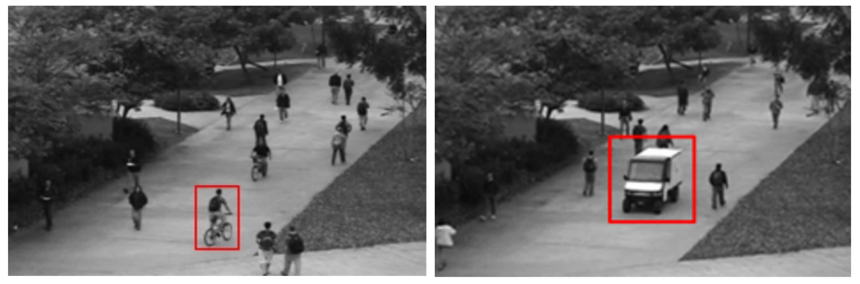
Details of your solution
Describe Your Solution
Initially, we segment the image using the SAM model.
We then leverage a knowledge graph to incorporate useful information in an on-the-fly manner, aiding in the polishing of the segments.
Based on the KG, we refine the segments by merging some of them.
Why Did You Use This Approach?
We believe that a knowledge graph is a valuable addition to VLMs (such as SAM) and would benefit research in glass detection in CPS (Cyber-Physical Systems) scenarios.
Autonomous Vehicle
Anomaly Detection

Slide 5
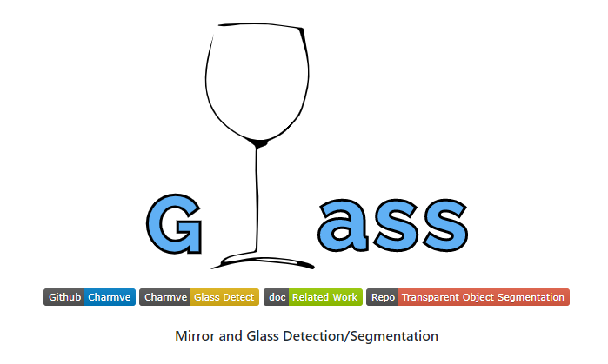
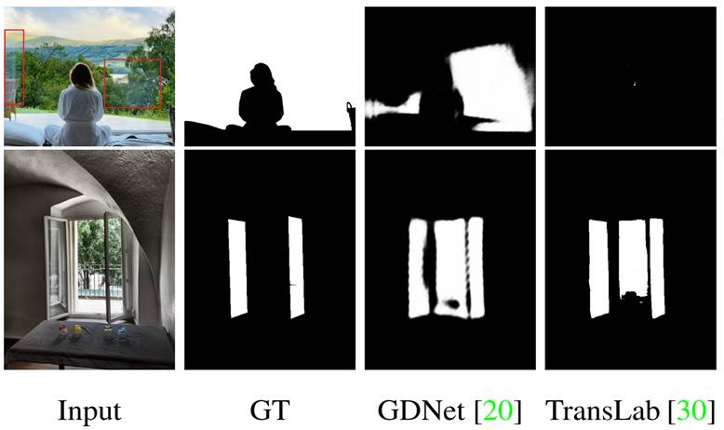
Evaluation
Dataset
CVPR2020_GDNet Dataset
5432 Images of windows and glass and their corresponding masks (we use a subset of 20)
Public dataset available on GitHub
Baseline
Acquired a baseline of 38.8 IoU when detecting the glass using facebook’s SAM model
IoU was used to determine the similarity of the segmented mask and the ground truth mask
Current result
We prove that although currently imperfect, knowledge graph can vastly improve the SAM model and segmentation capabilities

Slide 6
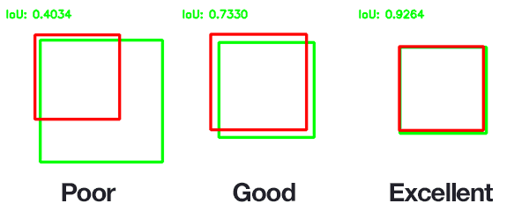
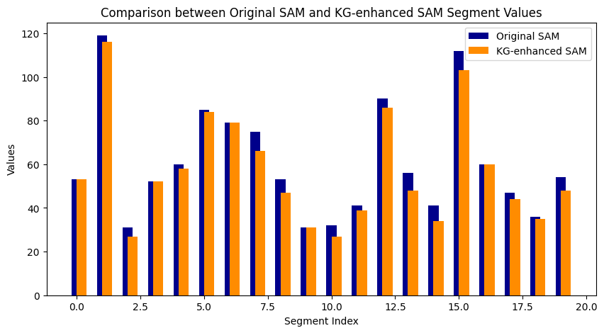
Evaluation
Performance (IOU)
We demonstrate an improvement in the SAM model's segmentation of glass.
Our method achieves an IOU of 41.6, which is an improvement of 7.2% compared with the SAM model, which has an IOU of 38.8.
Segment Simplification
We further prove that the number of segments is simplified by applying KG.

Slide 7
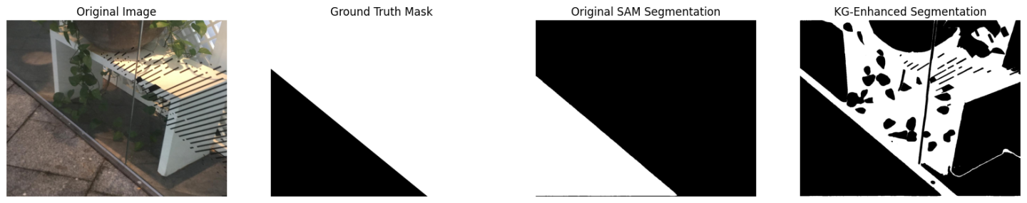
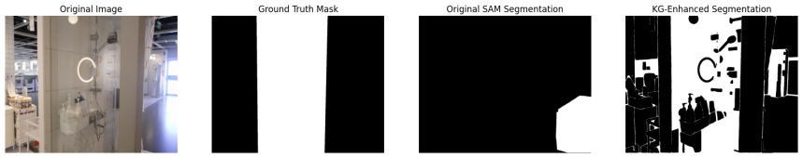
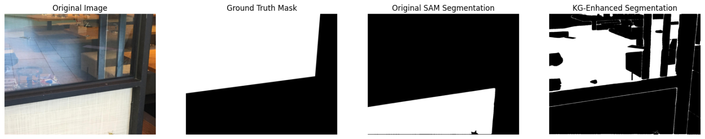
Evaluation (more results)
Our results

Slide 8
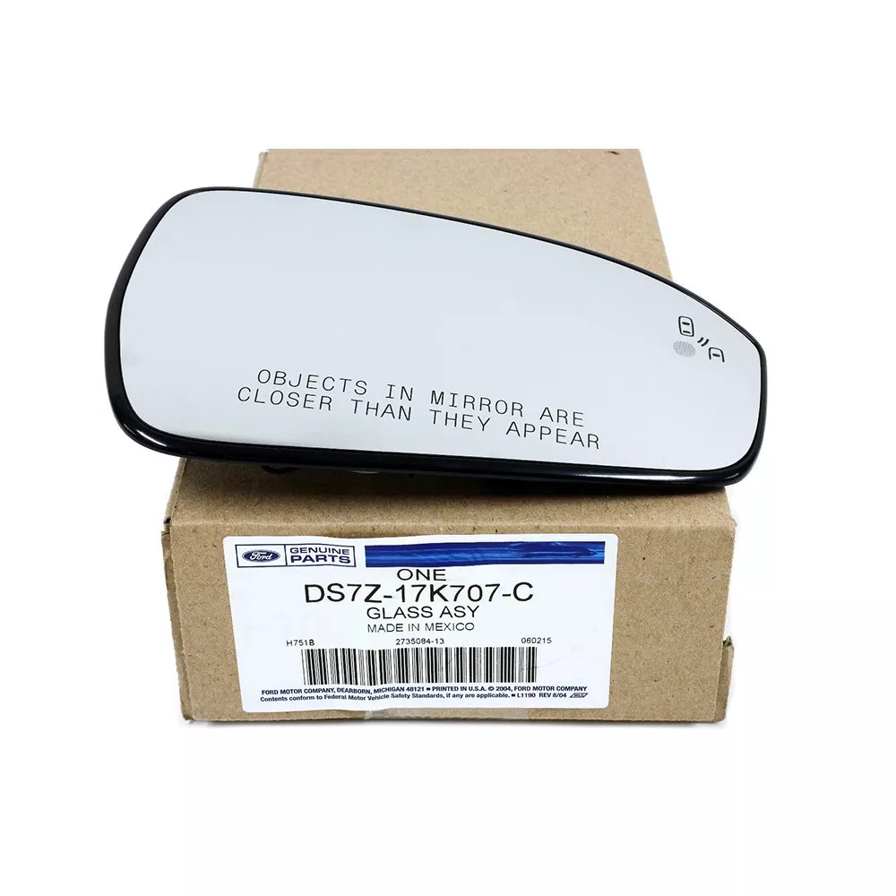
Discussion
Assumptions (and why they are reasonable)
We assume SAM model has the potential to be a good fit to glass detection in real-world practice (basis for this project)
Limitations
The current framework is only test on a limited dataset (20 datapoints) and the generealizability or robustness is not yet validified
Future direction
Inporate additional knowledge into the pipeline
Leverage more advanced model structure (i.e., GraphTransformer) to aggregate information in KG and improve performance

Slide 9
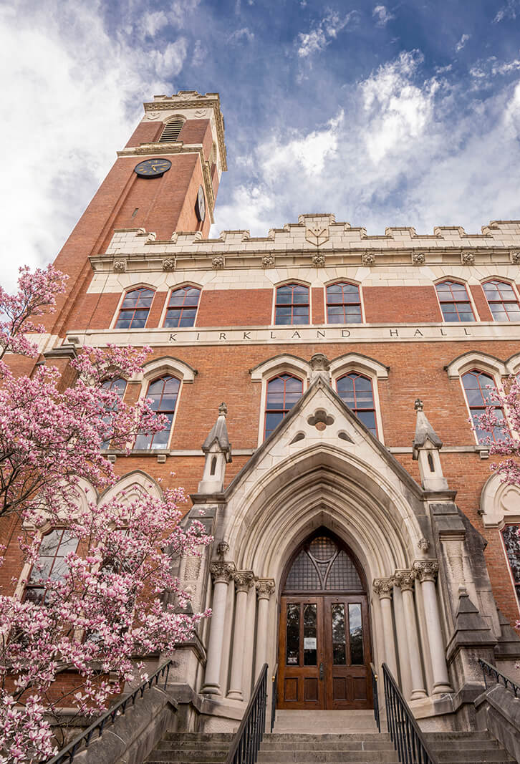
Summary
We demonstrate the issues in the current detection results when applying the SAM model.
We propose a pipeline to incorporate knowledge in the form of a knowledge graph (KG) to enhance the SAM model.
Specifically, we extend the current segmentation map produced by SAM in a neural-symbolic AI manner.
We prove the effectiveness of this pipeline and propose future work.

